Slide 1
CSE7302 - INTERNSHIP Final Review Presentation Real-Time Fixed Deposit Viewer Platform (FinTechora)
Student Details
Name | DHANUSH GOWDA B U
Roll No | 20221CSE0522
Section | 8CSE03
Under the Supervision of,
Dr.Megala G
Assistant Professor
Presidency School of CSE
Presidency University
Name of the Program: B.Tech – Computer Science & Engineering
Name of the HoD: Dr. Blessed Prince P
Name of the Program Internship Coordinator: Ms. Riya Sanjesh
Name of the School Internship Coordinator: Dr. Md Ziaur Rahman

Slide 2
About Company or Organization
BNP Paribas is a global banking organization
Headquartered in Paris, France
Operates in multiple countries
Provides banking and financial services

Slide 3
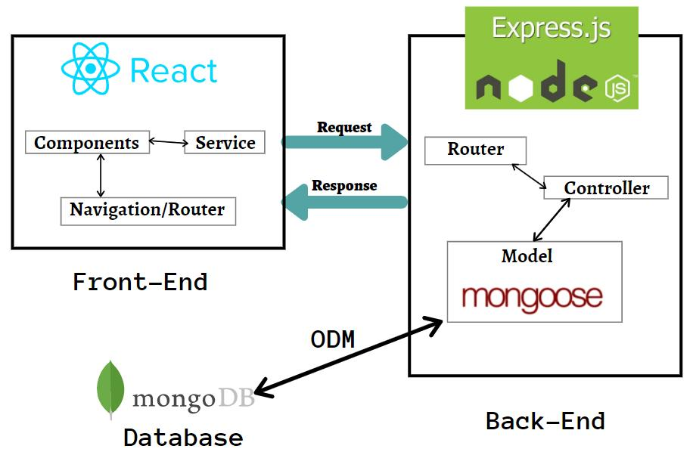
Working domain or the technology
MERN Stack Development
React + TypeScript frontend
Node.js and Express backend
MongoDB database
REST API communication

Slide 4
About your team and reporting Manager
Working in development team
Assigned to Fixed Deposit module
UI and dashboard implementation
Regular code review and feedback

Slide 5
Challenges Faced in Internship
Understanding project structure
Integrating finance calculations
Managing state across components
Handling real-time updates

Slide 6
Objectives of the work
Develop FD tracking dashboard
Show invested and maturity value
Track money growth in real-time
Improve full stack implementation

Slide 7
ABSTRACT
FinTechora is a real-time fixed deposit tracking platform
Provides dashboard to view investments and growth
Uses MERN stack for full stack development
Shows invested and maturity value clearly
Helps users track and analyze deposits easily

Slide 8
Literature Review
Study / Concept | Source URL | Limitation Observed → Implemented in Our System
Studied FD management systems | https://www.sbi.co.in | Shows deposit details but no unified dashboard. Our system provides one dashboard to track all FDs and growth.
Analyzed portfolio dashboards | https://www.moneycontrol.com | Focus mainly on stocks and mutual funds. Our system includes dedicated Fixed Deposit portfolio tracking.
Reviewed fintech payment apps | https://www.paytm.com | Displays FD info but limited maturity growth visualization. Our system shows invested vs maturity value clearly.
Observed investment growth models | https://www.investopedia.com | Explains growth formulas but not integrated with user dashboards. Our system calculates and shows growth automatically.
Studied banking FD services | https://www.icicibank.com | FD details are available but tracking multiple deposits is difficult. Our system lists all deposits in one view.

Slide 9
Literature Review
Reviewed financial tracking apps | https://www.etmoney.com | Tracks investments but FD insights are limited. Our platform provides FD-specific tracking and insights.
Analyzed wealth management dashboards | https://www.zerodha.com | Focus mainly on stock portfolios. Our system focuses on fixed deposit portfolio monitoring.
Studied digital banking platforms | https://www.hdfcbank.com | Users must navigate multiple pages to see FD information. Our system provides simple dashboard overview.
Reviewed fintech investment tools | https://www.groww.in | Mainly stock and mutual fund tracking. Our system supports fixed deposit monitoring and projections.
Studied financial education resources | https://www.rbi.org.in | Provides information on FD schemes but no real-time tracking tools. Our system implements live tracking dashboard for deposits.

Slide 10
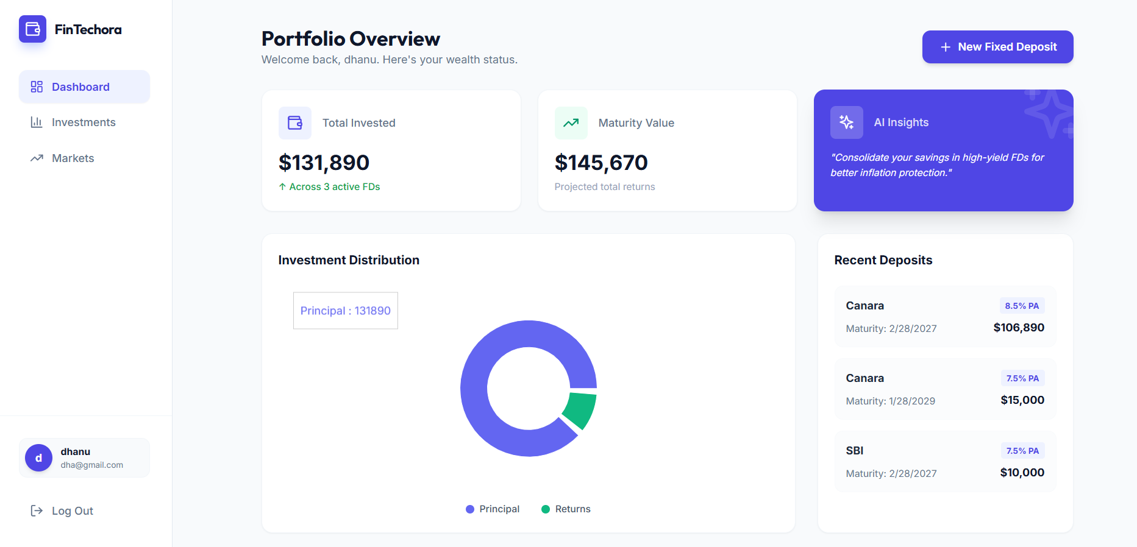
Proposed System / Work
Web-based FD tracking platform
User login and dashboard access
View total invested amount
View maturity value projection
Track active deposits

Slide 11
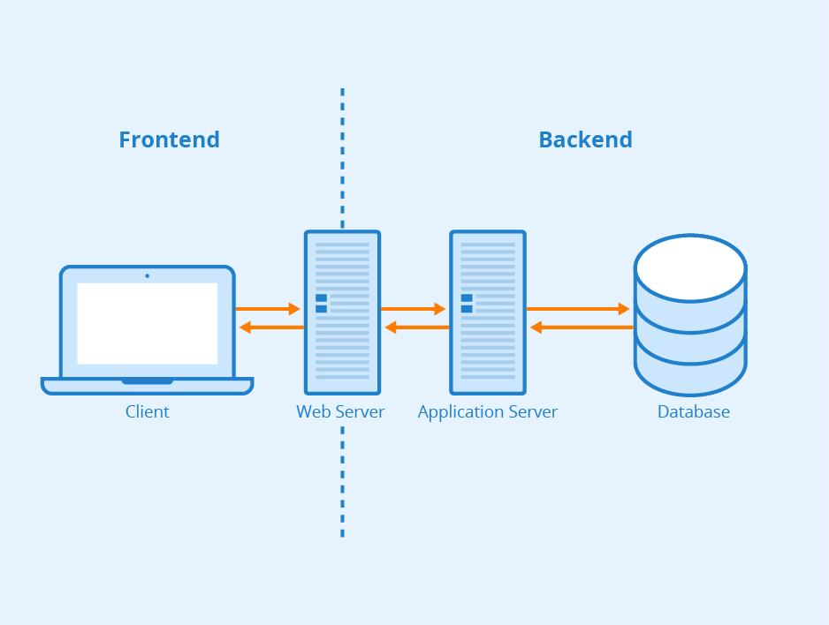
PROPOSED METHODOLOGY
User logs into system
Data fetched using APIs
Backend processes FD data
Finance logic calculates maturity value
Data stored in MongoDB
Dashboard displays results in real-time

Slide 12
Problem Statement
No centralized FD tracking system
Users cannot monitor growth easily
Need real-time portfolio overview
Need simple and clear dashboard

Slide 13
System Requirements
React (Frontend)
Node.js & Express
MongoDB
Vite build tool
Web browser

Slide 14
Advantages of Proposed System/Work
Real-time FD tracking
Clear investment summary
Maturity value projection
User-friendly dashboard

Slide 15
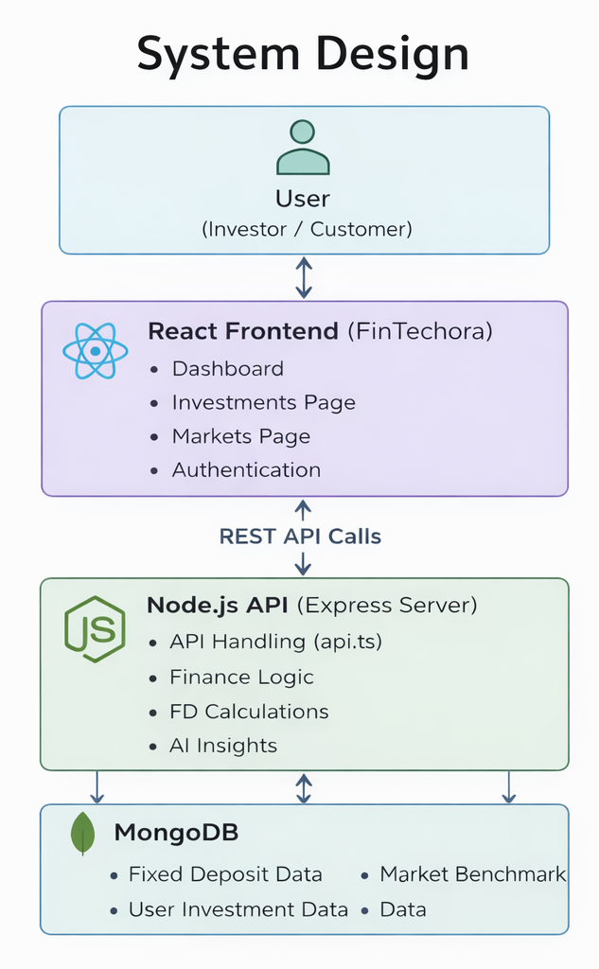
System Design

Slide 16
ALGORITHM / PSEUDOCODE
1. Start
2. User logs into system
3. Fetch FD data from database
4. For each deposit:
Calculate maturity value
Calculate returns
5. Store processed data
6. Display in dashboard
7. End

Slide 17
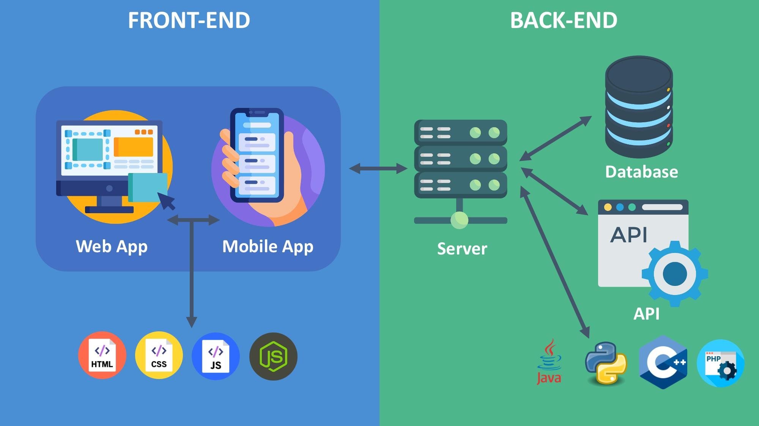
System Implementation
Dashboard UI developed using React
Fixed Deposit listing implemented
Investment summary calculation added
Finance logic for maturity value
API service integration implemented
AI insight feature integrated
Data storage handling added

Slide 18
DATASET
FD data is simulated or manually created
Contains:
Deposit amount
Interest rate
Duration
Institution
Used for testing dashboard and calculations

Slide 19
TEST CASES
Test Case | Input | Expected Output | Result
TC1 | Add FD | FD added successfully | Pass
TC2 | View dashboard | Data displayed correctly | Pass
TC3 | Calculate maturity | Correct value shown | Pass
TC4 | Invalid data | Error handled | Pass

Slide 20
RESULTS & DISCUSSION
Dashboard shows real-time FD
data
Maturity value calculated correctly
UI is responsive and user-friendly
System works without errors
Helps in better financial understanding

Slide 21

CONCLUSION & FUTURE WORK
Conclusion:
Developed FD tracking dashboard
Real-time visualization achieved
Improved user understanding
Future Work:
Add real bank API integration
Improve AI insights
Add mobile version
Enhance security

Slide 22
Internship Road Map
Note: Write in the below table what u will be achieving in each review
Review 1
Domain learning and setup
Review 2
Review 3
API integration and finance logic
Review 4
Final Review
FD dashboard UI development
Testing and
optimization
Complete system deployment

Slide 23
Github Link
https://github.com/dhanushbu2004/CSE7302-Internship

Slide 24
Q&A

Slide 25
Thank you !!

